Slide 1

Artificial Intelligence
Chapter 5: STOCHASTIC METHODS

Slide 2

OutLine
5.0 Introduction
5.1 The Elements of Counting
5.2 Elements of Probability Theory Capture Audience Attention
5.3 Bayes’ Theorem
5.4 Applications of the Stochastic Methodology
5.5 Epilogue and References
5.6 Exercises

Slide 3

I. Introduction
- Chapter 4 introduced heuristic search as an approach to problem solving in domains where either a problem does not have an exact solution or where the full state space may be too costly to calculate.
- In this chapter we propose the stochastic methodology as appropriate or these situations. Probabilistic reasoning is also suitable for situations where state information is found from sampling an information base and causal models are learned from data.

Slide 4
Introduction
- One important application domain for the use of the stochastic methodology is diagnostic reasoning where cause/effect relationships are not always captured in a purely deterministic fashion,
- Another interesting application for the stochastic methodology is gambling, where supposedly random events such as the roll of dice, the dealing of shuffled cards. In fact, in the 18th century, the attempt to provide a mathematical foundation for gambling was an important motivation for Pascal (and later Laplace) to develop a probabilistic calculus.

Slide 5
Introduction
- Finally, human decisions often emerge from complex, time-critical, and embodied environments where a fully mechanistic calculus may simply
- We next describe several problem areas, among many, where the stochastic methodology is often used in the computational implementation of intelligence; these areas will be major topics in later chapters.

Slide 6
Introduction
Diagnostic reasoning
- In medical diagnosis, for example, there is not always an obvious cause/effect relationship between the set of symptoms presented by the patient and the causes of these symptoms., such as monitoring aircraft or helicopter flight systems Rule-based and probabilistic systems have both been applied in these and other diagnostic domains.

Slide 7
Introduction
Natural language understanding.
- If a computer is to understand and use a human language, that computer must be able to characterize how humans themselves use that language. Words, expressions, and metaphors are learned, but also change and evolve as they are used over time. The stochastic methodology supports the understanding of language; for example, when a computational system is trained on a database of specific language use (called a corpus linguistics)

Slide 8
Introduction
Planning and scheduling.
- When an agent forms a plan, for example, a vacation trip by automobile, it is often the case that no deterministic sequence of operations is guaranteed to succeed. What happens if the car breaks down, if the car ferry is cancelled on a specific day, if a hotel is fully booked, even though a reservation was made? Specific plans, whether for humans or robots, are often expressed in probabilistic language.

Slide 9
Introduction
Learning
- An important component of many stochastic systems is that they have the ability to sample situations and learn over time. Some sophisticated systems are able to both sample data and predict outcomes as well as learn new probabilistic relationships based on data and outcomes. We consider learning in Part IV

Slide 10
Introduction
In Section 5.1 we introduce basic counting techniques, including the sum and product rules.
In Section 5.2, we introduce a formal language for reasoning with the stochastic methodology.
In Section 5.3, we present Bayes’ theorem which supports most approaches to stochastic modeling and learning. Bayes’ rule is important for interpreting new evidence in the context of the prior knowledge or experience.
In Section 5.4 we present two applications of stochastic methods, including probabilistic finite state automata and a methodology

Slide 11
5.1 The Elements of Counting
5.1.1 The Addition and Multiplication Rules
5.1.2 Permutations and Combinations

Slide 12
5.1.1 The Addition and Multiplication Rules
If we have set A:
The number of elements in set A is denoted by |A|.
|A| called the cardinality of A.
A maybe empty, finite, countably infinite, or uncountably infinite.

Slide 13
5.1.1 The Addition and Multiplication Rules
Example:
Empty set: The set of people in class who was born in 2018.
Finite set: The set of integer positive numbers is smaller than 10 and divide by 2 equal 0. B = {0, 2, 4, 6, 8}
Countably infinite: The set of natural number.
Uncountable infinite: The set of real number.

Slide 14

5.1.1 The Addition and Multiplication Rules
Each set is defined in terms of a domain of interest or universe, U, of elements that might be in that set.
Example:
The set of male people in a classroom may be defined in the context, or in the universe, of all the people in that room.
Similarly, the roll of a 3 on a fair die may be seen as one of a set of six possible outcomes.

Slide 15
5.1.1 The Addition and Multiplication Rules
The domain or universe of a set A is thus also a set and is used to determine the complement of that set.
Complement A is denoted by A.

Slide 16
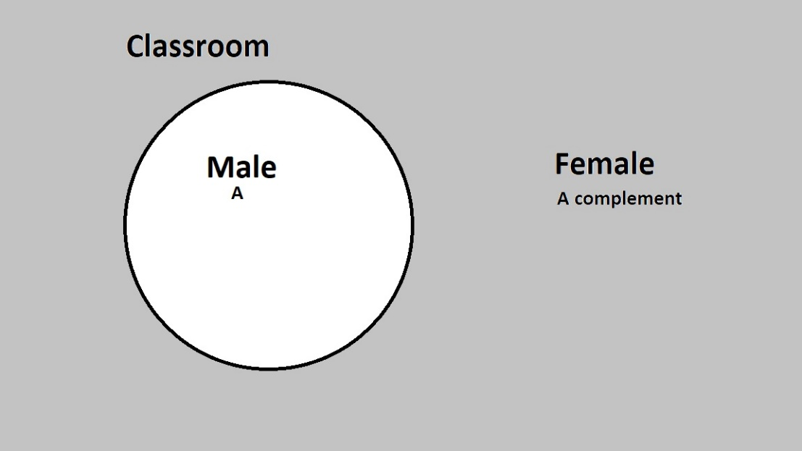
5.1.1 The Addition and Multiplication Rules
Example: Let A is the set of all male classroom
Complement of A is??? All female in classroom

Slide 17
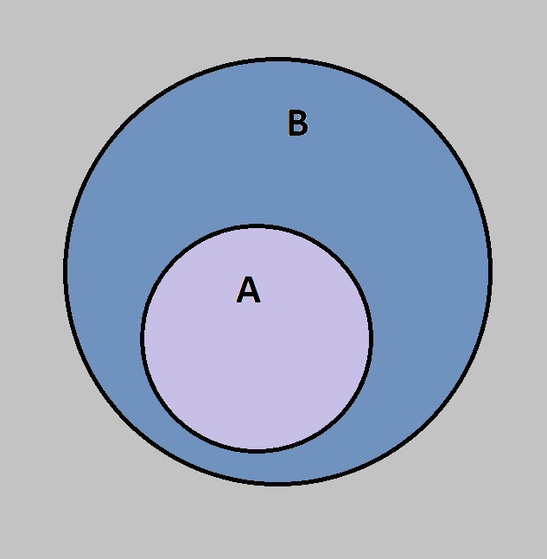
5.1.1 The Addition and Multiplication Rules
Subset:
  A is a subset of B when all element in A is also an element of set B.

Slide 18
5.1.1 The Addition and Multiplication Rules
Subset:
  A is a subset of B when all element in A is also an element of set B.
  It is denoted: A ⊆ B.
  Every set is a subset of itself.
  Any set A is a subset of its universe.
  An empty set is a subset of every set and it is denoted { } or Ø.

Slide 19
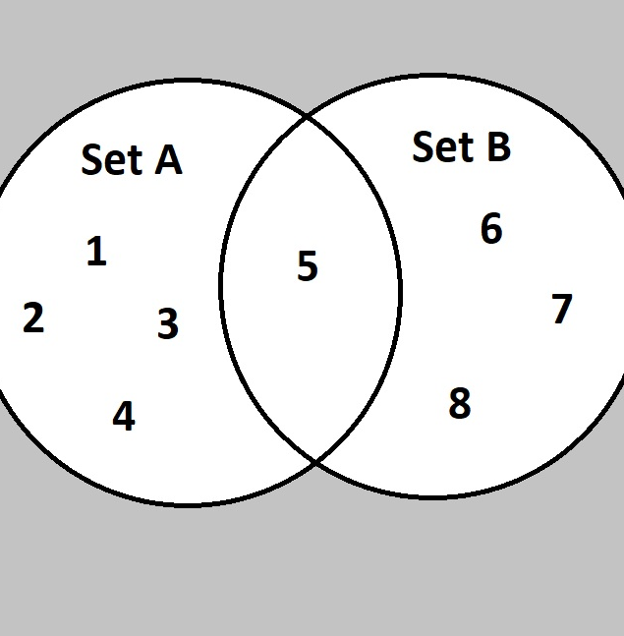
5.1.1 The Addition and Multiplication Rules
Union:
  The union of two sets A and B is the set of elements which are in A, in B, or in both A and B

Slide 20
5.1.1 The Addition and Multiplication Rules
Union:
  The union of two sets A and B, (A ∪ B) is the set of elements which are in A, in B, or in both A and B.
  The number of elements in the union of two sets is the total of all the elements in each of the sets minus the number of elements that are in both sets.
  A = {1, 2, 3, 4, 5}, |A| = 5
  B = {5, 6, 7, 8}, |B|= 4
  C is union of two sets A and B |C| = 5 + 4 – 1 = 8
  C = A ∪ B = {1, 2, 3, 4, 5, 6, 7, 8}

Slide 21
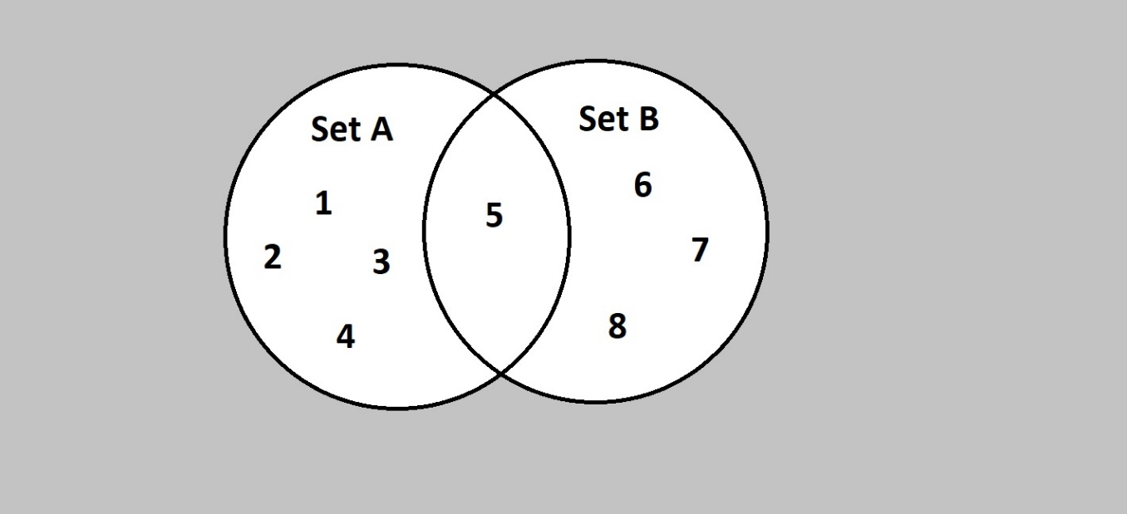
5.1.1 The Addition and Multiplication Rules
Intersection:
  The intersection of two sets A and B, A ∩ B, is the set of all elements common to both sets.

Slide 22
5.1.1 The Addition and Multiplication Rules
We now give examples of a number of the concepts just defined:
Suppose the universe, U, is the set {0, 1, 2, 3, 4, 5, 6, 7, 8, 9}
Let A be the set {1, 3, 5, 7, 9}
Let B be the set {0, 2, 4, 6, 8}
Let C be the set {4, 5, 6}
|A| = 5, |B| = 5, C = |3| and |U| = 10
Also, A ⊆ U, B ⊆ U, and A ∪ B = U, |B| = |A|, A = B
Further, |A ∪ B| = |A| + |B| = 10, since A ∩ B = { }
But A ∩ C = {5} so |A ∪ C| = |A| + |C| - | A ∩ C | = 5 + 3 – 1 = 7

Slide 23
5.1.1 The Addition and Multiplication Rules
We have just presented the major components for the addition rule for combining two sets. For any two sets A and C, the number of elements in the union of these sets is:
|A ∪ C| = |A| + |C| - |A ∩ C|
A similar addition rule holds for three sets A, B, and C
|A ∪ B ∪ C| = |A| + |B| + |C| - |A ∩ B| - |A ∩ C| - |B ∩ C| + |A ∩ B ∩ C|

Slide 24
5.1.1 The Addition and Multiplication Rules
The multiplication principle for counting states that if we have two sets of elements A and B of size a and b respectively, then there are a x b unique ways of combining the elements of the sets together.
Example: A company puts a code on each different product they sell. The code is made up of 3 numbers and 2 letters. How many different codes are possible?
Answer:
There are 5 stages (number 1, number 2, number 3, letter 1 and letter 2).
There are 10 possible numbers: 0 – 9.
There are 26 possible letters: A – Z.
So we have:
10 * 10 * 10 * 26 * 26 = 676000 possible codes.

Slide 25
5.1.1 The Addition and Multiplication Rules
The Cartesian product of two sets A and B, denoted A X B, is the set of all ordered pairs (a, b) where a is an element of set A and b is an element of set B; or more formally:
A X B = {(a, b) | (a ∈ A) ∧ (b ∈ B)}

Slide 26
5.1.1 The Addition and Multiplication Rules
Example:
Ex1: If A = {7, 8} and B = {2, 4, 6}, find A × B.
A × B = {(7, 2); (7, 4); (7, 6); (8, 2); (8, 4); (8, 6)}
The 6 ordered pairs thus formed can represent the position of points in a plane, if A and B are subsets of a set of real numbers.
Ex2: If A × B = {(p, x); (p, y); (q, x); (q, y)}, find A and B.
A is a set of all first entries in ordered pairs in A × B.
B is a set of all second entries in ordered pairs in A × B.
Thus A = {p, q} and B = {x, y}

Slide 27
5.1.2 Permutations and Combinations

Slide 28
5.1.2 The Permutations and Combinations
A permutation of a set of elements is an arranged sequence of the elements of that set.
Example:
An example permutation is an arrangement or ordering of a set of ten books on a shelf that can hold all ten.
Another example is the assignment of specific tasks to four of a group of six children.
Question???

Slide 29
5.1.2 The Permutations and Combinations
The number of permutations of n objects taken r at a time is
_{n}P_{r} = n(n - 1)(n - 2) ... (n - r + 1) = n! / (n - r)!
Example:
Suppose we have a set of three letters: A, B, and C. We might ask how many ways we can arrange 2 letters from that set. Each possible arrangement would be an example of a permutation. The complete list of possible permutations would be: AB, AC, BA, BC, CA, and CB.

Slide 30
5.1.2 The Permutations and Combinations
The combination of a set of n elements is any subset of these elements that can be formed.
As with permutations, we often want to count the number of combinations of items that can be formed, given a set of items.
The key idea here is that the number of combinations represents the number of subsets of the full set of elements that can be created.

Slide 31
5.1.2 The Permutations and Combinations
The number of Combinations of n objects taken r at a time is:
_{n}C_{r} = n(n - 1)(n - 2) ... (n - r + 1)/r! = n! / r!(n - r)! = _{n}P_{r} / r!
Example:
Suppose we have a set of three letters: A, B, and C. We might ask how many ways we can select 2 letters from that set. Each possible selection would be an example of a combination. The complete list of possible selections would be: AB, AC, and BC.

Slide 32
5.2 Elements of Probability Theory

Slide 33
5.2.1 The Sample Space, Probabilities, and Independence
Definition:
  ELEMENTARY EVENT: An elementary or atomic event is a happening or occurrence that cannot be made up of other events.
  Example: When a coin is tossed, the elementary events are:
  An event of obtaining a head.
  An event of obtaining a tail.
  EVENT, E: An event is a set of elementary events.
  Example: Set of students have GPA is greater than 80

Slide 34
5.2.1 The Sample Space, Probabilities, and Independence
Definition:
  SAMPLE SPACE, S: The set of all possible outcomes of an event E is the sample space S or universe for that event.
  Example: When you toss a coin, sample space is head and tail.
  PROBABILITY, p: The probability of an event E in a sample space S is the ratio of the number of elements in E to the total number of possible outcomes of the sample space S of E. Thus,
  p(E) = |E| / |S|.
Example: We say that the probability of the coin landing H is ½
And the probability of the coin landing T is ½

Slide 35
5.2.1 The Sample Space, Probabilities, and Independence
The blood groups of 200 people is distributed as follows: 50 have type A blood, 65 have B blood type, 70 have O blood type and 15 have type AB blood. If a person from this group is selected at random, what is the probability that this person has O blood type? (0.35)
Two cards are drawn from the pack of 52 cards. Find the probability that both are diamonds or both are kings. (14/221)
Notes:
An Elementary Event is any single outcome or element of a sample space. When two coins are tossed simultaneously, the possible outcomes are HH, HT, TH, and TT. Any one outcome like TT is called an elementary event of the sample space {HH, HT, TH, TT}.

Slide 36
5.2.1 The Sample Space, Probabilities, and Independence
Three dice are rolled together. What is the probability as getting at least one '4'?
A problem is given to three persons P, Q, R whose respective chances of solving it are 2/7, 4/7, 4/9 respectively. What is the probability that the problem is solved?
Notes:
An Elementary Event is any single outcome or element of a sample space. When two coins are tossed simultaneously, the possible outcomes are HH, HT, TH, and TT. Any one outcome like TT is called an elementary event of the sample space {HH, HT, TH, TT}.

Slide 37
5.2.1 The Sample Space, Probabilities, and Independence
The probability of the union of two sets of events :
|A ∪ B| = |A| + |B| - |A ∩ B|
p(A ∪ B) = p(A) + p(B) - p(A ∩ B)
Example: A tutoring service specializes in preparing adults for high school equivalence tests. Among all the students seeking help from the service, 63% need help in mathematics, 34% need help in English, and 27% need help in both mathematics and English. What is the percentage of students who need help in either mathematics or English?
Notes:
An Elementary Event is any single outcome or element of a sample space. When two coins are tossed simultaneously, the possible outcomes are HH, HT, TH, and TT. Any one outcome like TT is called an elementary event of the sample space {HH, HT, TH, TT}.

Slide 38
5.2.1 The Sample Space, Probabilities, and Independence
Solution:
Imagine selecting a student at random, that is, in such a way that every student has the same chance of being selected.
Let M denote the event “the student needs help in mathematics” and let E denote the event “the student needs help in English.”
The information given is that P(M)=0.63, P(E)=0.34, and P(M∩E)=0.27.
The Additive Rule of Probability gives:
P(M∪E) = P(M) + P(E) − P(M∩E) = 0.63 + 0.34 − 0.27 = 0.70
Notes:
An Elementary Event is any single outcome or element of a sample space. When two coins are tossed simultaneously, the possible outcomes are HH, HT, TH, and TT. Any one outcome like TT is called an elementary event of the sample space {HH, HT, TH, TT}.

Slide 39
5.2.1 The Sample Space, Probabilities, and Independence
Practice:
A volunteer is selected at random, meaning that each one has an equal chance of being chosen. Find the probability that:
1. His specialty is IT and he speaks two or more languages?
2. Either his specialty is IT or he speaks two or more languages?
3. His specialty is something other than IT?
Specialty | Language Ability
 | Single language | Two or more languages
IT | 6 | 2
BA | 12 | 1
BME | 4 | 3
Notes:
An Elementary Event is any single outcome or element of a sample space. When two coins are tossed simultaneously, the possible outcomes are HH, HT, TH, and TT. Any one outcome like TT is called an elementary event of the sample space {HH, HT, TH, TT}.

Slide 40

5.2.1 The Sample Space, Probabilities, and Independence
Specialty | Language Ability
 | Single language (S) | Two or more languages (T) | Total
IT (I) | 6 | 2 | 8
BA (B) | 12 | 1 | 13
BME (E) | 4 | 3 | 7
Total | 22 | 6 | 28
Solution:
The probability sought is P( I ∩ T). The table shows that there are 2 such people, out of 28 in all, hence P(I∩T)=2∕28≈0.07 or about a 7% chance.
The probability sought is P (I U T). The third row total and the grand total in the sample give P(M)=8∕28. The second column total and the grand total give P(T)=6∕28. Thus using the result from part (1),
P (I U T) = P (I) + P(T) – P( I ∩ T) = $\frac{8}{28}+ \frac{6}{28} − \frac{2}{28}= \frac{12}{28}$
Notes:
An Elementary Event is any single outcome or element of a sample space. When two coins are tossed simultaneously, the possible outcomes are HH, HT, TH, and TT. Any one outcome like TT is called an elementary event of the sample space {HH, HT, TH, TT}.

Slide 41

On the other hand, the event of interest can be thought of as the complement M^{c}of M, hence using the value of P(M)P(M) computed in part (b),
5.2.1 The Sample Space, Probabilities, and Independence
Specialty | Language Ability
 | Single language (S) | Two or more languages (T) | Total
IT (I) | 6 | 2 | 8
BA (B) | 12 | 1 | 13
BME (E) | 4 | 3 | 7
Total | 22 | 6 | 28
Solution:
This probability can be computed in two ways. Since the event of interest can be viewed as the event C ∪ E and the events C and E are mutually exclusive, the answer is, using the first two row totals,
P ( B U E ) = P (B) + P(E) - P ( B ∩ E ) = $\frac{13}{28}+ \frac{7}{28} −\frac{0}{28}=\frac{20}{28}$
On the other hand, the event of interest can be thought of as the complement M of M, hence using the value of P(M) computed in part (2),
P ( M complement ) = 1 – P ( M ) = $1−\frac{8}{28}= \frac{20}{28}$
Notes:
An Elementary Event is any single outcome or element of a sample space. When two coins are tossed simultaneously, the possible outcomes are HH, HT, TH, and TT. Any one outcome like TT is called an elementary event of the sample space {HH, HT, TH, TT}.

Slide 42
5.2.1 The Sample Space, Probabilities, and Independence
Independent events: Two events A and B are independent if and only if the probability of their both occurring is equal to the product of their occurring individually. This independence relation
is expressed:
p(A ∩ B) = p(A) * p(B)
Example: There are 8 bit strings of length four that end with a 0: {1110, 1100, 1010, 1000,0010, 0100, 0110, 0000}. There are also 8 bit strings that have an even number of 1s: {1111, 1100, 1010, 1001, 0110, 0101, 0011, 0000}. The number of bit strings that have both an even number of 1s and end with a 0 is 4: {1100, 1010, 0110, 0000}. Now these two events are independent since
p({even number of 1s} ∩ {end with 0}) = p({even number of 1s}) x p({end with 0})
4/16 = 8/16 x 8/16 = 1/4
Notes:
An Elementary Event is any single outcome or element of a sample space. When two coins are tossed simultaneously, the possible outcomes are HH, HT, TH, and TT. Any one outcome like TT is called an elementary event of the sample space {HH, HT, TH, TT}.

Slide 43
5.2.1 The Sample Space, Probabilities, and Independence
A card is chosen at random from a deck of 52 cards. It is then replaced and a second card is chosen. What is the probability of choosing a jack and then an eight? (1/169)
A jar contains 3 red, 5 green, 2 blue and 6 yellow marbles. A marble is chosen at random from the jar. After replacing it, a second marble is chosen. What is the probability of choosing a green and then a yellow marble? (15/128)
Notes:
An Elementary Event is any single outcome or element of a sample space. When two coins are tossed simultaneously, the possible outcomes are HH, HT, TH, and TT. Any one outcome like TT is called an elementary event of the sample space {HH, HT, TH, TT}.
Two events, A and B, are independent if the fact that A occurs does not affect the probability of B occurring

Slide 44
5.2.1 The Sample Space, Probabilities, and Independence
Probabilistic Inference: is the task of deriving the probability of one or more random variables taking a specific value or set of values.
Example:
Suppose you are driving the interstate highway system and realize you are gradually slowing down because of increased traffic congestion. You begin to search for possible explanations of the slowdown. Could it be road construction? Has there been an accident?

Slide 45
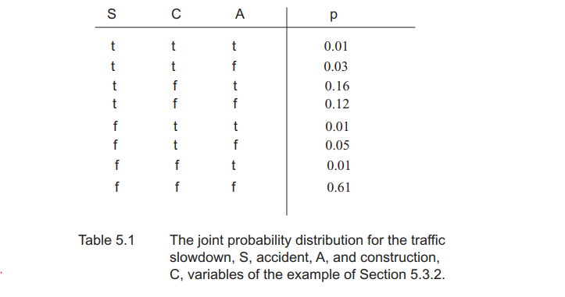
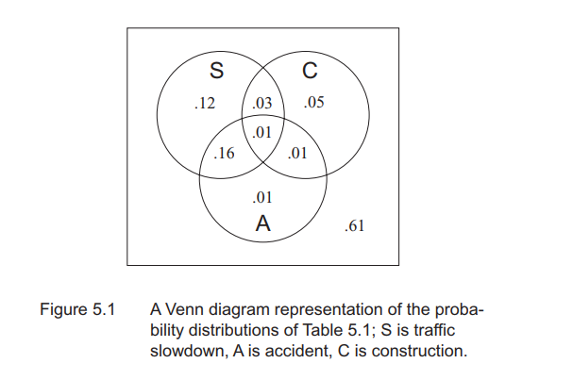
5.2.1 The Sample Space, Probabilities, and Independence
We can also work out the probability of any simple or complex set of events.

Slide 46
5.2.1 The Sample Space, Probabilities, and Independence
Random Variables: is a function whose domain is a sample space and range a set of outcomes, most often real numbers. Rather than using a problem-specific event space, a random variable allows us to talk about probabilities as numerical values that are related to an event space.
A discrete random variable, which includes boolean random variables as a subset, is a function from the sample space to (a countable subset of) real numbers in [0.0, 1.0].
-A continuous random variable has as its range the set of real numbers

Slide 47
5.2.1 The Sample Space, Probabilities, and Independence
Example: Discrete Random Variable
For example, if a coin is tossed three times, the number of heads obtained can be 0, 1, 2 or 3. The probabilities of each of these possibilities can be tabulated as shown:
In this example, the number of heads can only take 4 values (0, 1, 2, 3) and so the variable is discrete. The variable is said to be random if the sum of the probabilities is one.

Slide 48
5.2.1 The Sample Space, Probabilities, and Independence
Example: Continuous Random Variable
  Height of students in class
  Weight of students in class
  Time it takes to get to school
  Distance traveled between classes

Slide 49

5.2.1 The Sample Space, Probabilities, and Independence
- Binomial Distribution: can be thought of as simply the probability of a SUCCESS or FAILURE outcome in an experiment or survey that is repeated multiple times.
- The outcome of any situation where we want to measure r successes in n trials, where p is the known probability of success may be represented as:

Slide 50

5.2.1 The Sample Space, Probabilities, and Independence
Example: Calculate the probability of obtaining 5 heads in 7 flips of a fair coin.
n = 7
r = 5
p = ½

Slide 51
5.2.1 The Sample Space, Probabilities, and Independence
Expectation: If the reward for the occurrence of an event E, with probability p(E), is r, and the cost of the event not occurring, 1 - p(E), is c, then the expectation derived from an event occurring, ex(E), is:
ex(E) = r x p(E) + c x (1 - p(E))

Slide 52
5.2.1 The Sample Space, Probabilities, and Independence
Example: Suppose that a fair roulette wheel has integers through 36 equally spaced on the slots of the wheel. In the game each player places $1 on any number she chooses: if the wheel stops on the number chosen, she wins $35; otherwise she loses the dollar. The reward of a win is $35; the cost of a loss, $1. Since the probability of winning is 1/37, of losing, 36/37, the expected value for this event, ex(E), is:
ex(E) = 35 (1/37) + (-1) (36/37) ≈ -0.027

Slide 53
5.2.4 Conditional Probability
A.1 PRIOR PROBABILITY
-The prior probability, generally an unconditioned probability , of an event is the probability assigned based on all knowledge supporting its occurrence or absence, that is,
the probability of the event prior to any new evidence. The prior probability of an
event is symbolized: p(event).

Slide 54
5.2.4 Conditional Probability
A.2 POSTERIOR PROBABILITY
-The posterior (after the fact) probability, generally a conditional probability, of an event is the probability of an event given some new evidence. The posterior probability of an event given some evidence is symbolized: p(event | evidence).

Slide 55
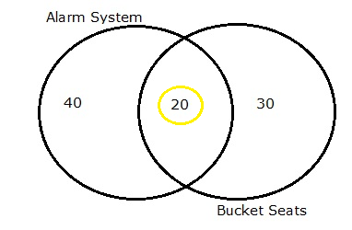
5.2.4 Conditional Probability
Example 1
In a group of 100 sports car buyers, 40 bought alarm systems, 30 purchased bucket seats, and 20 purchased an alarm system and bucket seats. If a car buyer chosen at random bought an alarm system, what is the probability they also bought bucket seats?

Slide 56
5.2.4 Conditional Probability
Solution:
Step 1: Figure out P(A). It’s given in the question as 40%, or 0.4.
Step 2: Figure out P(A∩B). This is the intersection of A and B: both
happening together. It’s given in the question 20 out of 100
buyers, or 0.2.
Step 3: Insert your answers into the formula:
P(B|A) = P(A∩B) / P(A) = 0.2 / 0.4 = 0.5.
The probability that a buyer bought bucket seats, given that they purchased an alarm system, is 50%.

Slide 57


5.2.4 Conditional Probability
#Since the sample space for determining the probabilities of the numerator and denominator are the same, we get:
p(d|s) = p(d∩s) / p(s).
-There is an equivalent relationship for p(s|d); p(s|d) = p(s∩ d) / p(d).
-We next solve the p(s|d)equation to determine the value for p(s∩d):
p(s∩ d) = p(s|d) p(d).
Bayes’ rule:

Slide 58
5.2.4 Conditional Probability
Apply the Chain Rule: for two sets A1 and A2
p(A1∩ A2) = p(A1| A2) p(A2) = p(A2| A1) p(A1).
Extend :
p(A1∩ A2∩... ∩ An) = p(A1) p(A2| A1) p(A3| A1∩ A2) .... p(An| ∩ Ai)

Slide 59
5.2.4 Conditional Probability
Example 2:
An ordinary deck of 52 playing cards is randomly divided into 4 piles of 13 cards each. Compute the probability that each pile has exactly 1 ace.

Slide 60
5.2.4 Conditional Probability
Solution:
Define events Ei ; i = 1; 2; 3; 4;
E1 = ace of spades is in any one of the piles
E2 = face of spades and ace of hearts are in different piles
E3 = faces of spades, hearts, and diamonds are all in different piles
E4 = f4 aces are in different piles

Slide 61
5.2.4 Conditional Probability
Solution:
- P(E1) = 1
- P(E2 | E1) = (52 - 13)=(52 - 1) = 39=51
- P(E3 |E1E2) = (52 - 13 x 2)=(52 - 2) = 26=50
- P(E4 | E1E2E3) =(52 - 13 x 3)=(52 - 3) = 13=49
- P(E4) = P(E1E2E3E4)
= P(E1)P(E2|E1)P(E3|E1E2)P(E4|E1E2E3)
= 1 x (39 / 51) x (26 /50) x (13/49)

Slide 62
5.2.4 Conditional Probability
B.1:INDEPENDENT EVENTS
-Two events A and B are independent of each other if and only if p(A∩ B) = p(A) p(B). When p(B)≠0 this is the same as saying that p(A) = p(A|B). That is, knowing
That B is true does not affect the probability of A being true.

Slide 63
5.2.4 Conditional Probability
Example:
A card is selected at random from an ordinary deck of 52 playing cards. Let A be the event that the selected card is an ace and H be the event that it is a heart, then are A and H independent?
Solution:
-P(A) = 4 / 52
-P(H) = 13 / 52
-P(AH ) = 1 / 52 = P(A) P(H)
-A and H are independent (but not mutually exclusive)

Slide 64
5.2.4 Conditional Probability
B.2: CONDITIONALLY INDEPENDENT EVENTS:
-Two events A and B are said to be conditionally independent of each other, given Event C if and only if p((A∩ B) | C) = p(A | C) p(B | C).

Slide 65
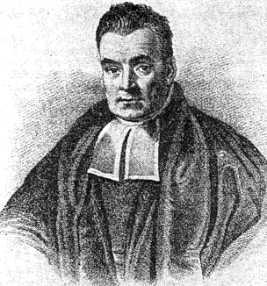
Bayes’ Theorem

Slide 66

Bayes’ Theorem
Conditional Probability: $P\left(A | B\right)= \frac{P(A ∩ B)}{P(B)}$
$P\left(B | A\right)= \frac{P(B ∩ A)}{P(A)}$
$$→P\left(A | B\right)= \frac{P\left(B | A\right).P(A)}{P(B)}$$
Ex: What is the probability of two girls given at least one girl?

Slide 67

Bayes’ Theorem
Ex: What is the probability of two girls given at least one girl?
A: We have 2 girls.
B: We have at least 1 girl.
$$P\left(A | B\right)= ?$$
$$=\frac{P\left(B | A\right) . P\left(A\right)}{P(B)}$$
$$=\frac{1/4}{3/4}=\frac{1}{3}$$

Slide 68





Bayes’ Theorem
Ex: We have 2 buckets. The first one has 3 red balls and 3 blue balls inside. The second one has 4 red balls and 2 blue balls. If I randomly choose a blue ball, what is the probability being in 1st bucket?
E: A blue ball is drawn.
h1: Came from 1st bucket.
h2: Came from 2nd bucket.
$P\left(E | h1\right)= \frac{1}{2}$
$=P\left(E∩h1\right)+P(E∩h2)$
$=P\left(E | h1\right).P\left(h1\right)+P\left(E | h2\right).P(h2)$
$=\frac{1}{2}.\frac{1}{2}+ \frac{1}{3}.\frac{1}{2}=\frac{5}{12}$
$=\frac{\frac{1}{2} .\frac{1}{2}}{\frac{5}{12}}=\frac{3}{5}$
$$P\left(E | h2\right)= \frac{1}{3}$$
$$P\left(E\right)$$
$$\frac{P\left(E | h1\right) . P\left(h1\right)}{P(E)}$$
$P\left(h1 | E\right)$ $=$

Slide 69

Bayes’ Theorem
$$P\left(E\right)=P\left(E∩h1\right)+P(E∩h2)$$
$=P\left(E | h1\right).P\left(h1\right)+P\left(E | h2\right).P(h2)$
Genarally: $P\left(E\right)= \sum_{j}{P\left(E | hj\right) . P(hj)}$
$$P\left(hi | E\right)=\frac{P\left(E | hi\right) . P\left(hi\right)}{\sum_{j}{P\left(E | hj\right) . P(hj)}}$$
$P\left(hi | E\right):$ the probability that $hi$ is true given evidence $E$.
$P\left(hi\right):$ the probability that $hi$ is true.
$P\left(E | hi\right)$ is the probability of observing evidence $E$when $hi$is true.

Slide 70
5.4 Applications of the Stochastic Methodology
**The most important is that use probability measures to reason about the interpretation of ambiguous information
1. PROBABILISTIC FINITE STATE MACHINE
A probabilistic finite state machine is a finite state machine where the next state function is a probability distribution over the full set of states of the machine.
Example: The finite state machine (Input the value) → output value (with sort of internal mechanism) to keep tack information of input value → FMS is a finite, directed, connected graph, having a set of states, a set of input values, and a state transition function → Thus the FSM can be seen as an abstract model of computation.

Slide 71
5.4 Applications of the Stochastic Methodology
2. PROBABILISTIC FINITE STATE ACCEPTOR
-A probabilistic finite state machine is an acceptor, when one or more states are indicated as the start states and one or more as the accept states.
-Example: where: ∃s0∈ S such that the input stream starts at s0, and ∃sn∈ S, an accept state. The input stream is accepted if it terminates in that state. In fact, there may be a set of accept states. The finite state acceptor is represented as
(S, s0, {s n}, I, F)

Slide 72
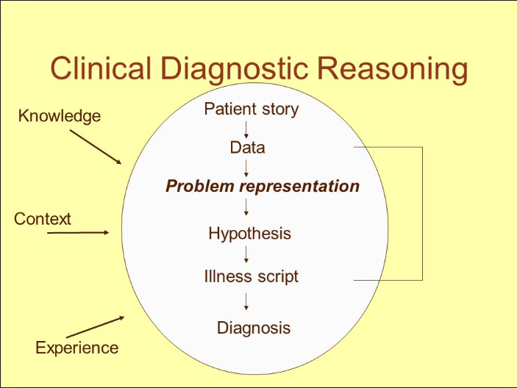
5.4 Applications of the Stochastic Methodology
• Diagnostic Reasoning:
* In medical diagnosis, for example:
- There is not always an obvious cause/effect relationship between the set of symptoms presented by the patient and the causes of these symptoms. In fact, the same sets of symptoms often suggest multiple possible causes.

Slide 73
5.4 Applications of the Stochastic Methodology
Machine Learning:
Use probabilistic models (Bayes’ and Markov’s algorithms) to interpret new experiences based on prior learned relationships. Many stochastic systems have the ability to sample situations and learn over time. Some are able to both sample data and predict outcomes as well as learn new probabilistic relationship

Slide 74
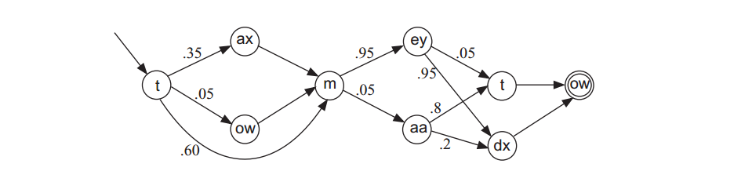
5.4.1 : So How Is “Tomato” Pronounced?
Example:
-A particular acceptable pronunciation for the word tomato is characterized by a path from the start state to the accept state.
-The decimal values that label the arcs of the graph represent the probability that the speaker will make that particular transition in the state machine
- The machine can try to determine the probabilistic path that best completes that word

Slide 75
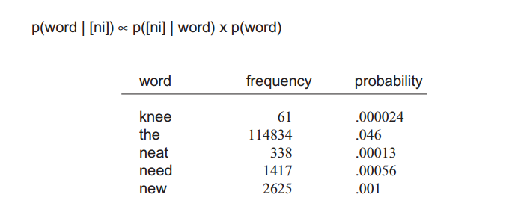
5.4.1 : So How Is “Tomato” Pronounced?
• Natural language understanding:
-> Statistical natural language processing uses stochastic methods, especially to resolve difficulties that arise because longer sentences are highly ambiguous when processed with realistic grammars, yielding thousands or millions of possible analyses.

Slide 76
5.4.2 Extending the Road/Traffic Example
Example :
You are driving, and realize you are gradually slowing down because of increased traffic congestion . Then search for the reason the explain why. Could it be road construction? Has there been an accident? Perhaps there are other possible explanations

Slide 77
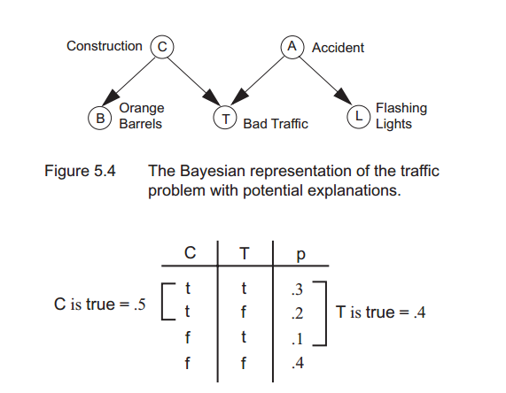
5.4.2 Extending the Road/Traffic Example
Solution
- After a few minutes you come across orange barrels at the side of the road that begin to cut off the outside lane of traffic. At this point you determine that the best explanation of your slow down is road construction. At the same time the alternative hypothesis of accident is explained away.
-Similarly if you would have seen flashing lights in the distance ahead, such as from a police vehicle or an ambulance, the best explanation given this evidence would be a traffic accident and road construction would have been explained away.

Slide 78
5.5 Epilogue and References
As noted in the chapter, probabilistic reasoning begins with determining principles of counting and combinatorics.
Actually, one of the first combinatorial “machines” is attributed to Raon Llull (Ford et al. 1995), automatically enumerate the attributes of God, with the intention of converting heathens. The first publication on probabilities,

Slide 79
5.5 Epilogue and References
The definitions of probabilities presented in Section 5.2.1 are based on the formalism proposed by the French mathematician Pierre Simon Laplace.
Thomas Bayes was a mathematician and a minister. His famous theorem was published in 1764, after his death.
The mathematicians of the early twentieth century, completed the foundation of modern probability theory continuing the “subjective/objective” debates on the nature of probabilities

Slide 80
5.5 Epilogue and References
We have chosen the second approach to probabilistic reasoning, feeling this orientation is a bit more intuitive, bringing to bear all the counting and other techniques of set theory, as seen in Section 5.1
Bayes’ theorem has offered a foundation for several expert systems of the 1970s and1980s

Slide 81
The naive Bayes approach has been used in a number of classification problems, including pattern recognition, natural language processing and elsewhere.
**Domingos and Pazzani (1997) offer justification for the successes of naive Bayes classifiers in situations which do not meet Bayesian independence assumptions.
Uncertain reasoning makes up a component of AI conferences, including AAAI, IJCAI, NIPS, and UAI

